Slide 1
Lab 4
k8s Horizontal Pod Autoscaling (HPA)

Slide 2
What is HPA?
Before HPA, websites crashed under load - you had to manually add servers
HPA acts like a smart store manager:
Monitors the app’s load (CPU/Memory)
Adds Pods when “busy”
Removes Pods when “idle”
Goal: Match the number of Pods to the current traffic needs automatically

Slide 3
The 3 components for our Demo
Metrics Server: Reports CPU/Memory for all pods.
Deployment: Our application to scale
HPA Object: Define the scaling rules (what to watch & when to scale)

Slide 4
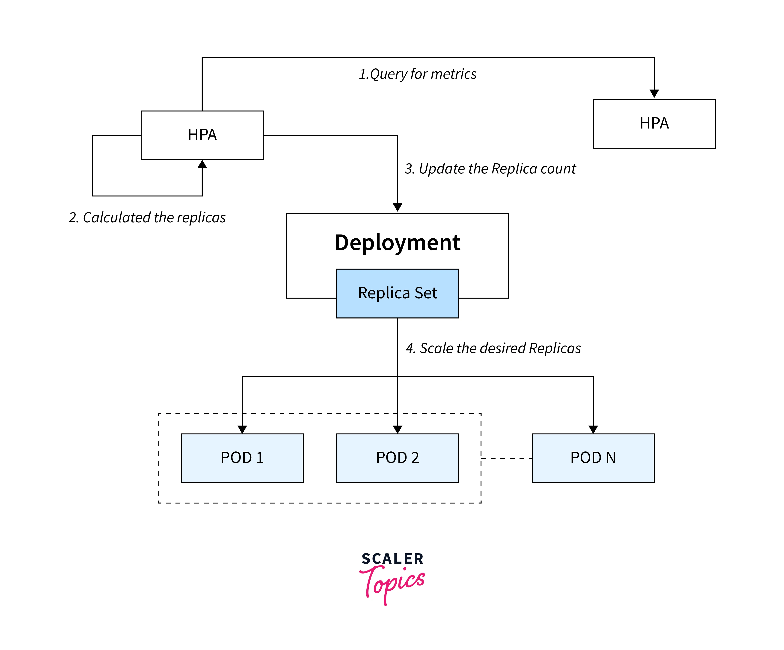
Metrics Server

Slide 5
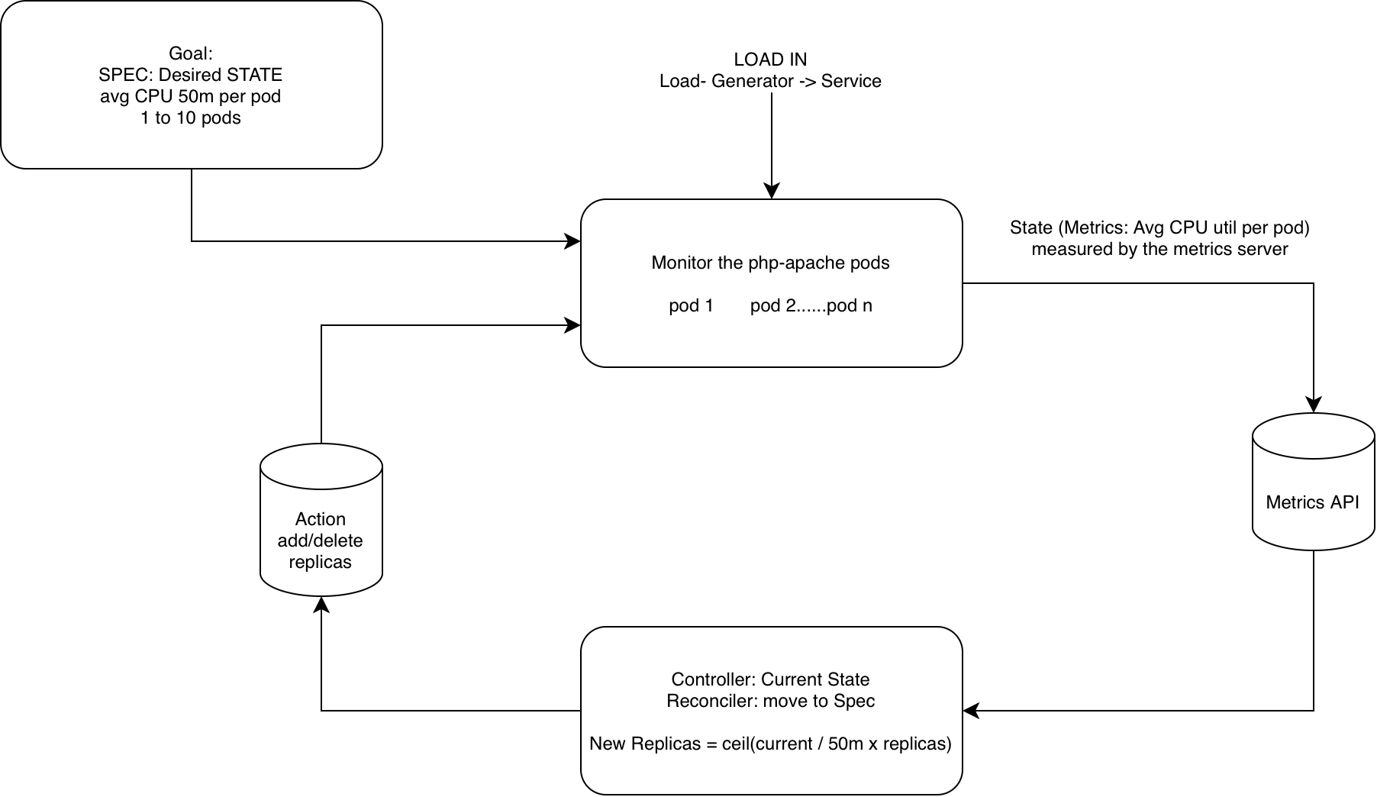

Slide 6
Requests, Limits and Units
Requests: Guaranteed CPU for each pod (used by HPA math)
Limits: Max CPU or Memory resource allowed
m : millicores
Units:
• 1000m = 1 CPU core
• Pod requests: 200m (20%)
• HPA desired target: 50m (5%)
Rule: If avg pod CPU util > 50m → Scale up!
Notes:
Note: To mention explanation on what happens when avg CPU util < 50m

Slide 7
HPA Math: Scale-Up Formula
desiredReplicas =
ceil( currentMetric / desiredMetric * currentReplicas )
Example:
currentMetric=626m
desiredMetric=50m
currentReplicas=1
=> ceil(626/50*1)=13
Capped to 10 if maxReplicas is set to 10

Slide 8
Demo 1a: Let's Scale with CPU!
🎯 Goal: Watch the HPA react to a massive CPU spike.
Steps:
• Navigate to Demo1/CPU
• Build App: docker build -t php-apache-cpu
• Deploy: kubectl apply -f php-deployment.yaml
• Create HPA: kubectl create -f DeployCPU.yaml
• Watch outputs: kubectl get hpa -w
• Run Load Generator
Observe HPA scaling up automatically.

Slide 9
Demo 1a: the php-apache app
David, describe the app briefly, show the contents of php-apache-cpu, php-deployment.yaml and DeployCPU.yaml

Slide 10
Demo 1a: traffic generation
David,
show the file content
describe the locust app (bursts, etc.)

Slide 11
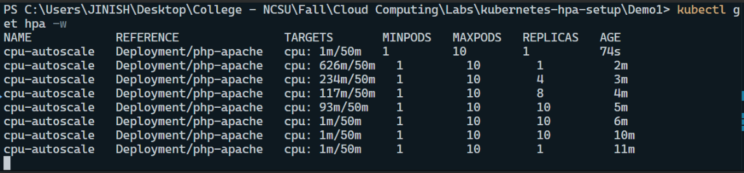
Demo 1a Output
Observed 3 scale up actions, at minutes 3, 4, 5
Observed 1 scale down action at minute 10
Is this behavior consistent/can it be explained by the HPA formula?
Notes:
How the number of replicas is calculated during the stabilization windows

Slide 12
Demo 1a Output (Analysis)
K8s has additional objectives besides autoscaling:
1) Don’t scale abruptly
(Default 5-min window)
Notes:
How the number of replicas is calculated during the stabilization windows

Slide 13
Demo 1a Output (Analysis)
K8s has additional objectives besides autoscaling:
2) Prevent flapping during transient dips
(Default 5-min window)
After 5 minutes of low load → returns to minReplicas.
Notes:
How the number of replicas is calculated during the stabilization windows

Slide 14
Demo 1b: Autoscaling Memory
🎯 Goal: Watch HPA react to memory load.
Steps:
• Navigate to Demo1/Memory
• Build: docker build -t php-apache-mem .
• Deploy and create HPA
• Watch scaling with kubectl get hpa -w
• Run memory load generator
Observation: Won’t scale down due to memory leak — HPA sees high usage.

Slide 15
Units for Memory
Units:
• Mi = Mebibyte (the 1024-based “computer” megabyte)
• Gi = Gibibyte (the 1024-based “computer” gigabyte)
Mebibyte != Megabyte
Mi = Mebibyte = 2^20 bytes = 1048576 bytes
M = Megabyte = 10^6 bytes = 1000000 bytes
Rule: If avg pod Memory > 25Mi → Scale up!

Slide 16
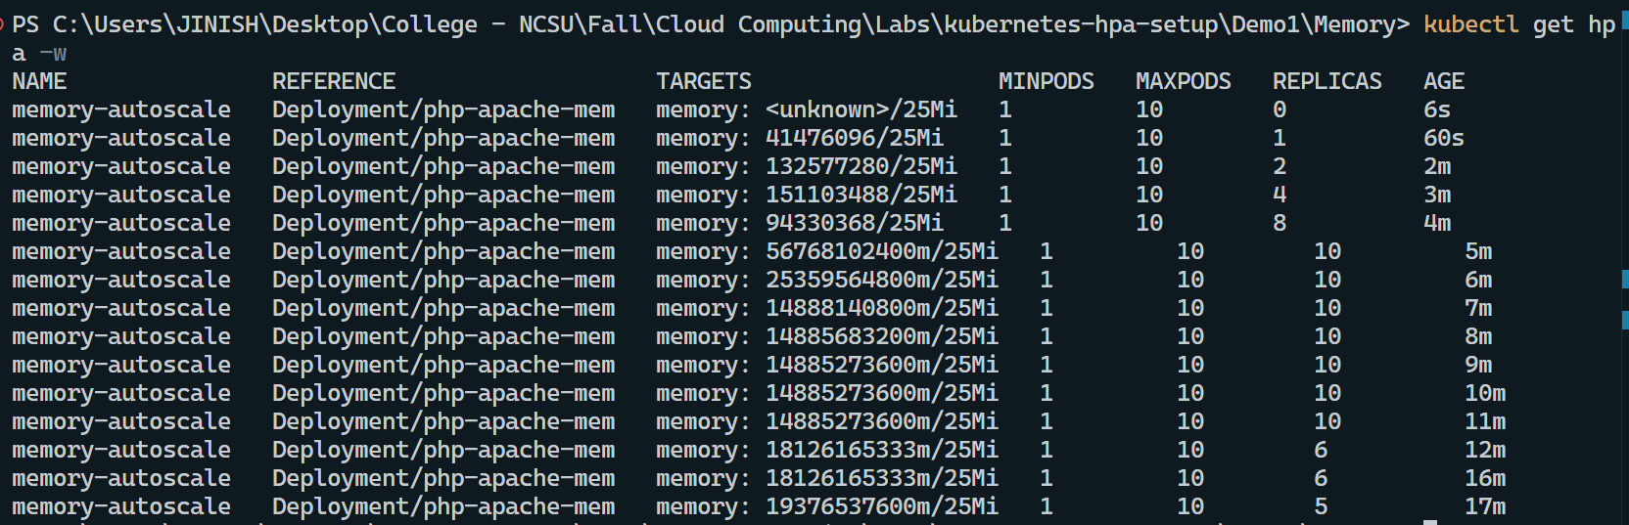
Demo 1b Output (Analysis)
Notes:
Why the term memory leak

Slide 17
Key Takeaways
✅ HPA auto-scales Pods based on metrics
✅ Needs Metrics Server
✅ Define rules via YAML
✅ Safety:
• Scale-Up Velocity: Controlled growth
• Scale-Down Cooldown: Prevents flapping
HPA isn’t magic—it simply follows the metrics and rules you define.
Notes:
Rules for scale-up velocity

Slide 18
Questions
Github - https://github.ncsu.edu/CSC-574/Lab-4
Thank you

